Slide 1

STREAMERS Climate Change: An analysis of World temperature and CO2 emissions. Temitope Adeniyi Feven Belay Neca Bryan
T

Slide 2

OVERVIEW
This is an analysis of the Earth’s surface temperature from 1900- 2013 and CO2 data from 1990-2018 to determine the trends and to build models to predict the variability of the World future temperatures

Slide 3

OBJECTIVES
Affirms the consensus on global warming.
Highlight temperature and Carbon dioxide trends across the major industrial countries of the world.
To use the dataset to build machine learning model to predict the variation of the world`s future temperatures.

Slide 4
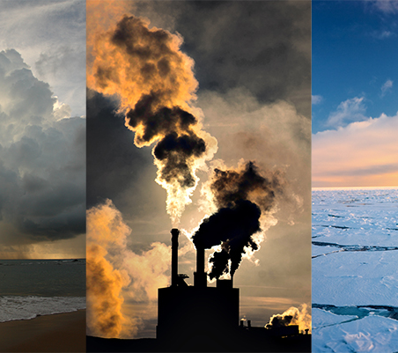
PROJECT QUESTIONS
Climate Change
What is the trends of average temperature of the world?
What is the trends Co2 emissions in the world ?
To determine most appropriate machine learning models for the datasets
To calculate the accuracy and precision of the models?

Slide 5


CONTENTS The areas of focus for this analysis will be
Technologies – Python, Jupyter Notebook, PostgreSQL, Tableau
Database for creating tables and ascending data.
Machine Learning to predict variations from world temperature, trends of temperature, predict whether dataset above or below the world mean temperatures
Summary of Results of Data exploratory Phase, Data Analysis and Machine learning

Slide 6



TECHNOLOGIES
Python – Sqlalchemy- to load into the PostgreSQL
Jupyter Notebook – preprocessing data and to run ML
PostgreSQL – to store the ‘Climate_Change DB’ and create new tables
Tableau Public - visualizing data

Slide 7
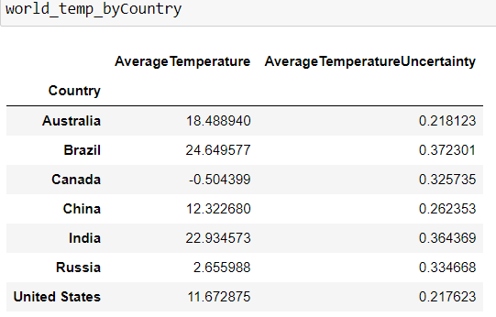
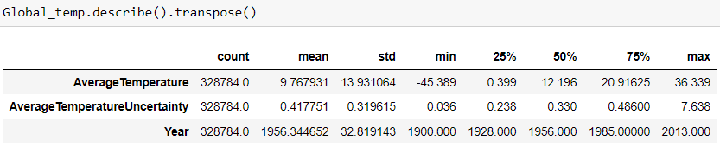
DATA EXPLORATION PHASE World temp on Jupyter Notebook

Slide 8
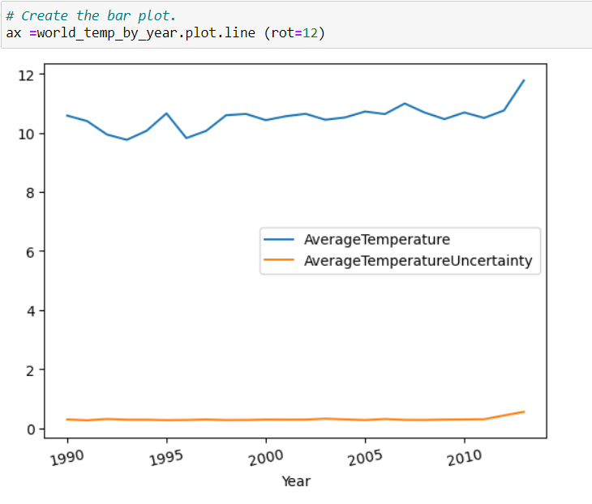
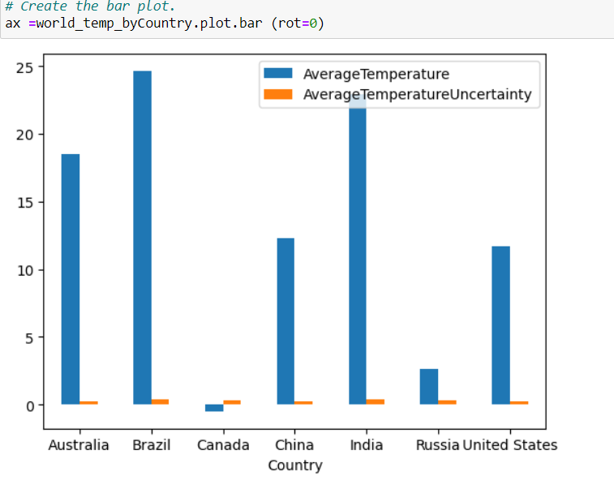
Data Exploration Phase of world temp on Jupyter Notebook

Slide 9
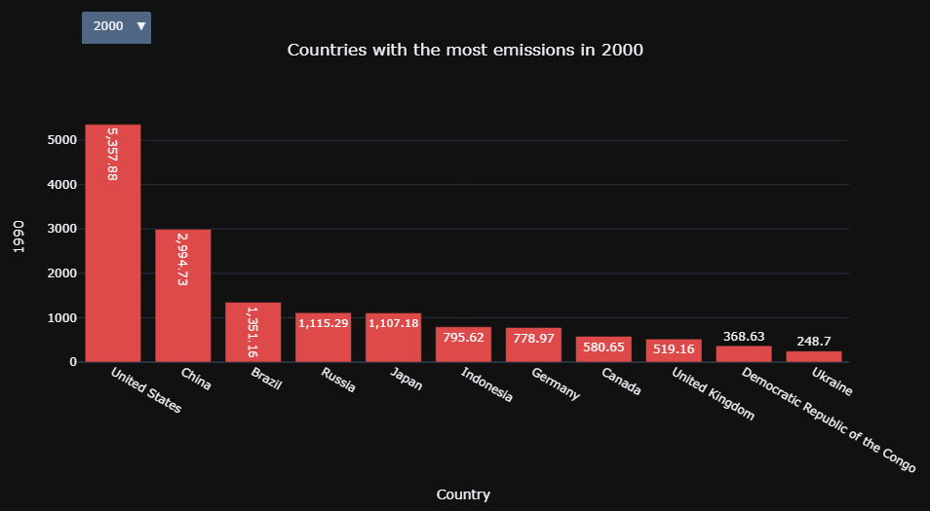
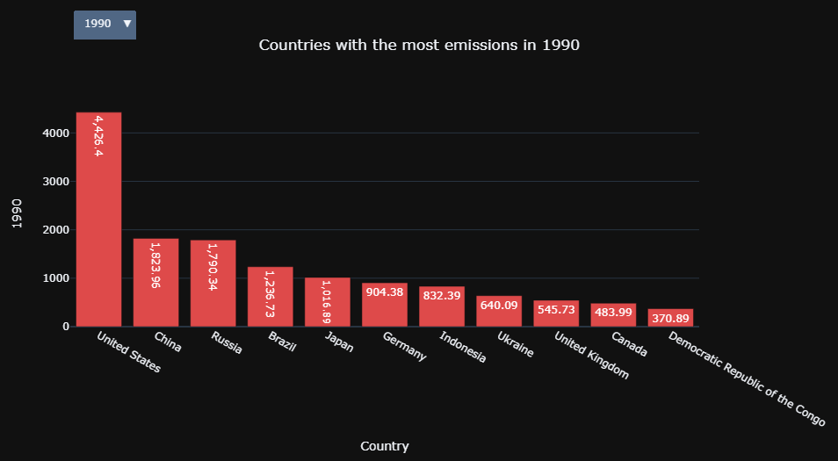
Data Exploration Phase of world Co2 emissions on Jupyter Notebook
Before 2005 USA was main contributor Co2 emissions

Slide 10
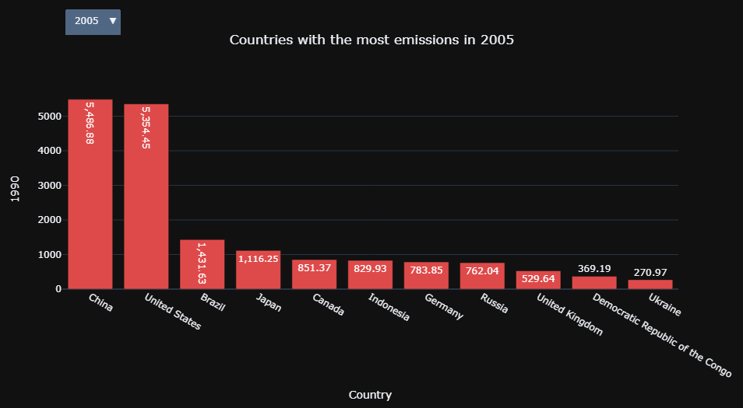
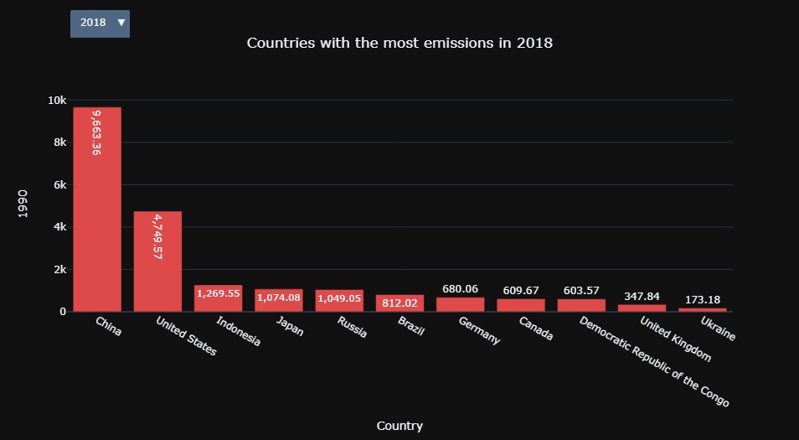
Data Exploration Phase of world Co2 emissions on Jupyter Notebook
China overtook USA as main contributor Co2 emissions by 2005 and more than double USA emissions by 2018

Slide 11
DATABASE PostgreSQL

Slide 12
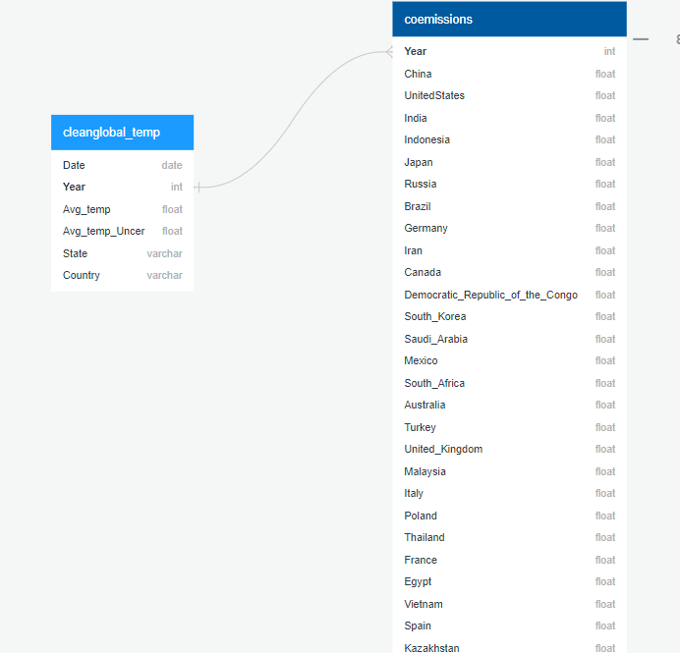
Entity Relationship Diagram

Slide 13
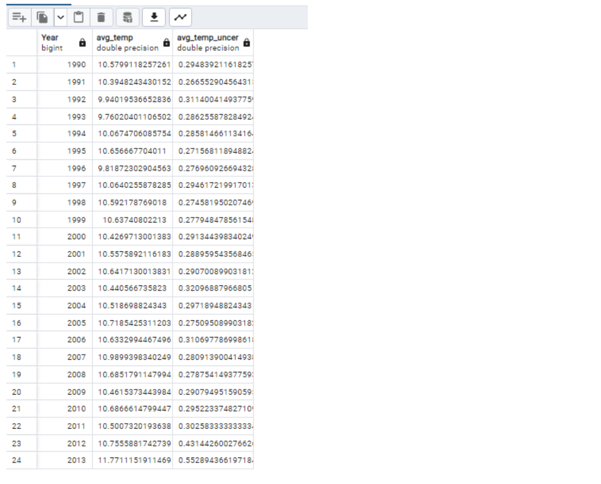
Climate_temp table
SELECT cg."Year", avg(cg."Avg_temp") AS Avg_temp,avg(cg."Avg_temp_Uncer") AS Avg_temp_Uncer
INTO climate_temp
FROM cleanglobal_temp AS cg
Group BY cg."Year"
Order by cg."Year"ASC;

Slide 14
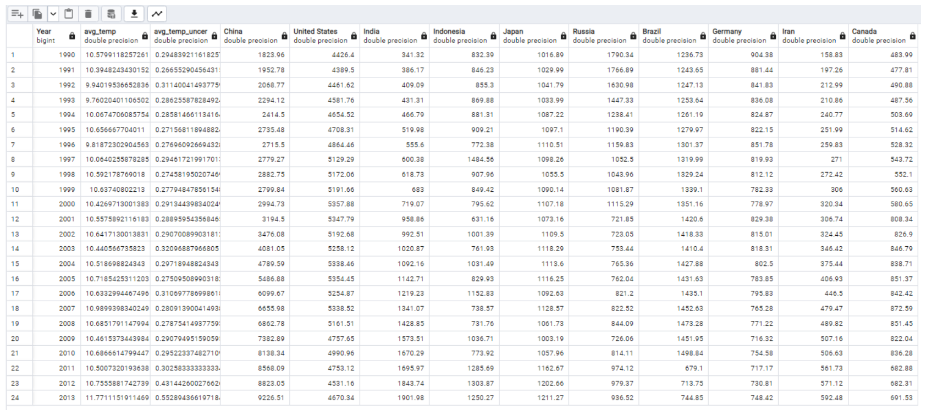
SELECT ct."Year",ct.avg_temp,ct.avg_temp_uncer, co."China",co."United States",co."India", co."Indonesia",co."Japan",co."Russia",co."Brazil",co."Germany",co."Iran",co."Canada" INTO global_climate FROM climate_temp AS ct LEFT JOIN coemissions As co ON co."Year" = ct."Year";
Global_Climate table

Slide 15
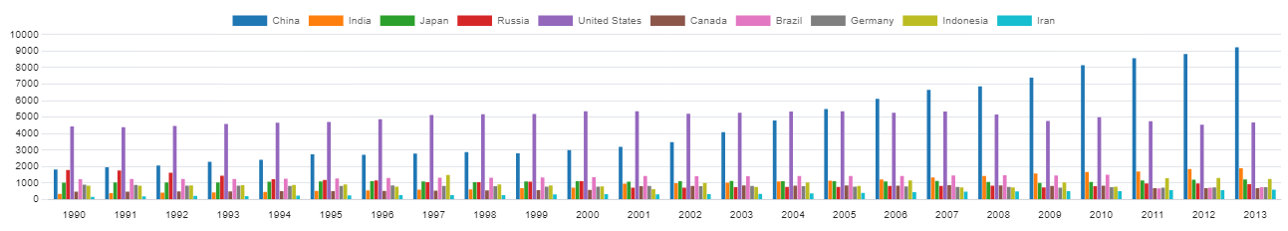
Global Emissions China and the United States has the most CO2 emissions.

Slide 16
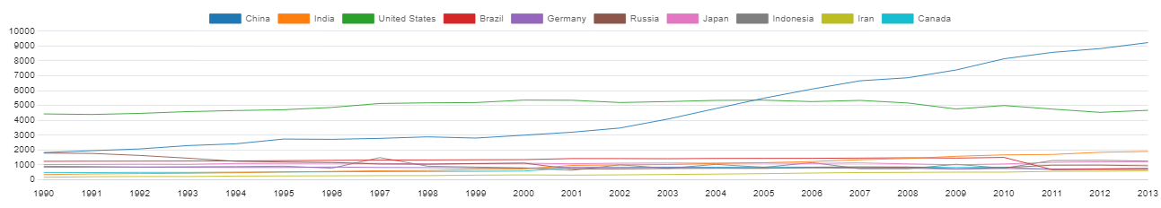
Global Emissions China and the United States has the most CO2 emissions.

Slide 17
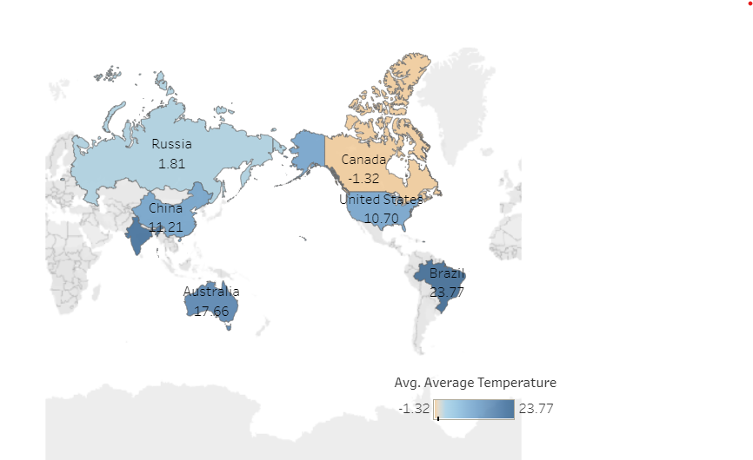
Tableau Public

Slide 18

RESULTS
https://public.tableau.com/views/NetflixBestMovies/ClimateChangestory?:language=en-US&:display_count=n&:origin=viz_share_link

Slide 19
Machine Learning Decision Tree Model (DT) Random Forest Model (RF) A mix of classification and and regression techniques to address imbalance data.

Slide 20
BENEFITS
Robust against overfitting
Rank importance of input variables
Robust to outliers & non –linear data
Efficient for large datasets

Slide 21

PROCESS
Extract cleaned, renamed & formatted data
Preprocessing
Split the data into training & testing
Instantiate model
Fit the model
Making predictions using the testing data
Calculate the balanced accuracy score
Notes:
Preprocessing-transformed columns to numerical values (specific to ML use model only used numeric)

Slide 22
RESULTS
Decision Tree
Random Forest
Accuracy Score – 68%
Classification Report
Confusion Matrix
Accuracy Score – 71%.
Classification Report
Confusion Matrix
Precision Recall F1Score
0 0.64 0.64 0.64 1 0.72 0.72 0.72
Precision Recall F1 Score 0 0.66 0.70 0.68 1 0.75 0.72 0.73
Predicted0 Predicted1
Actual0 23024 12983
Actual1 13052 33137
Predicted0 Predicted1
Actual 0 25373 10778
Actual1 13043 33002
Notes:
Recall – identify positive samples (sensitivity)
F1 Score – weighted avg of true positive rate
Precision – reliability of the model when positive classifications are made

Slide 23
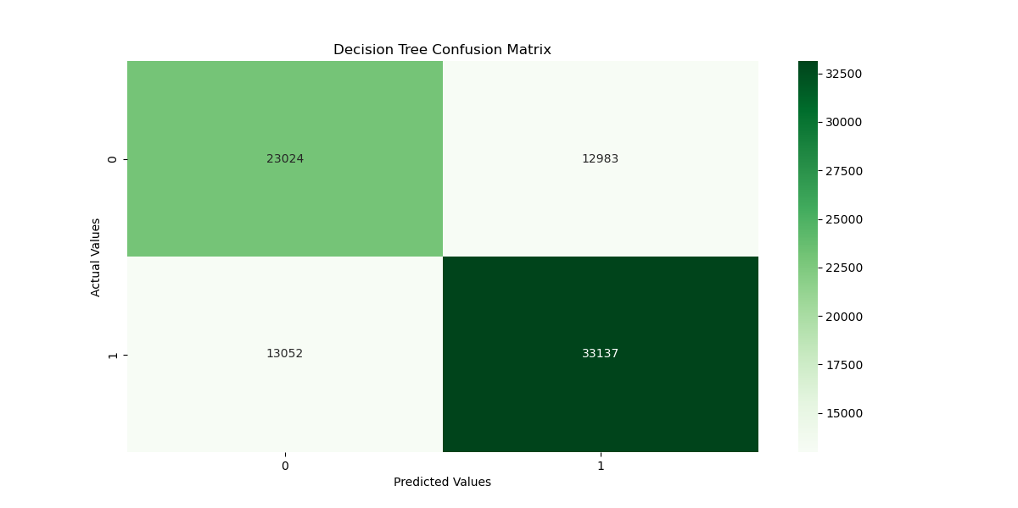
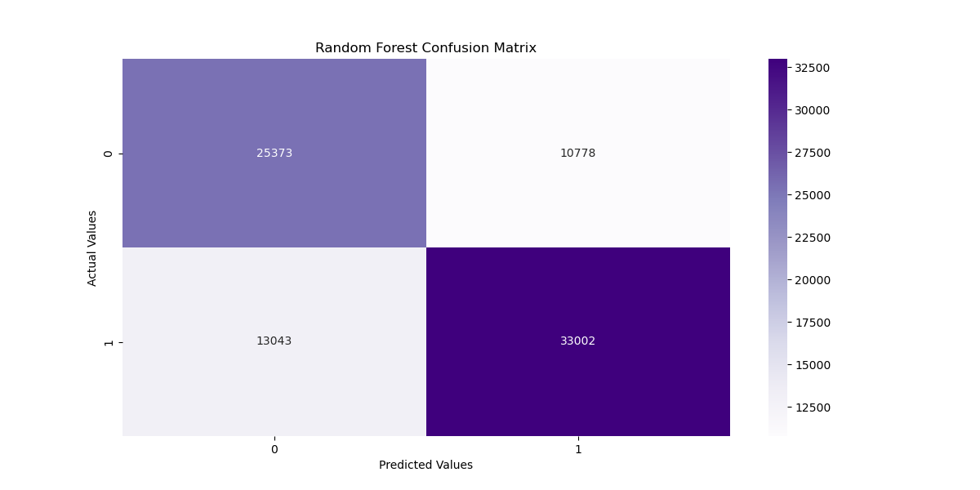
RESULTS
Decision Tree
Random Forest
Notes:
Recall – identify positive samples (sensitivity)
F1 Score – weighted avg of true positive rate
Precision – reliability of the model when positive classifications are made

Slide 24

Random Forest ML Results
List the features in order importance
AverageTemperatureUncertainty
(0.36085115372033477)
Year: (0.21958864244658743)
Country: (0.20989706071406417)
State: (0.20966314311901363)

Slide 25




SUMMARY
The world avg temperature rose by 3.3point from 1900- 2013.
China and USA are the major contributors of Co2 emissions.
Recommendations
Doing the analysis with better temperature data
Doing Neural Network Model

Slide 26
RESOURCES
Berkeley Earth, affiliated Lawrence Berkeley National Laboratory
Climate Watch Data

